Slide 1



Data Migration
CS 649 Big Data Tools and Methods
Meeta Kapoor
Red Id: 827533129

Slide 2
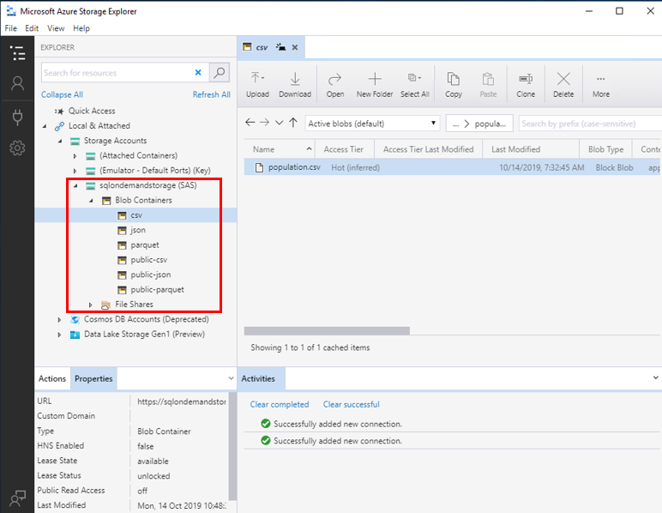
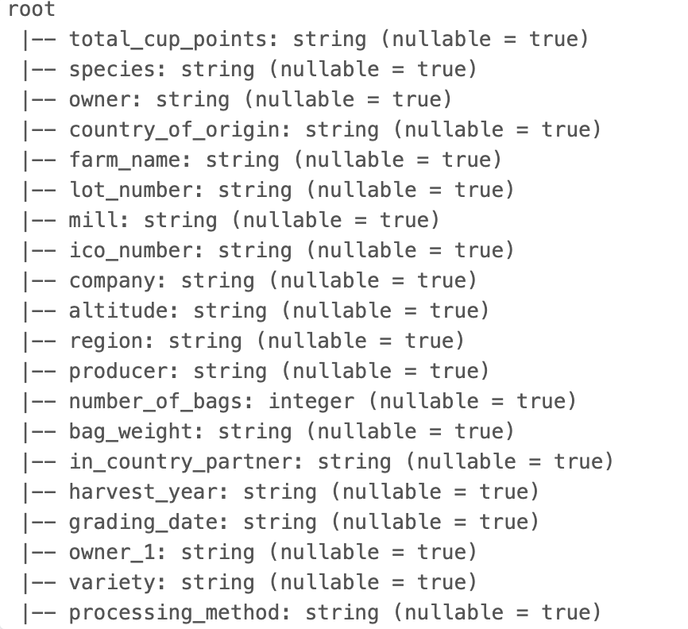
Source Data
coffee_details.csv
Details of kinds of coffee (1347 rows)

Slide 3
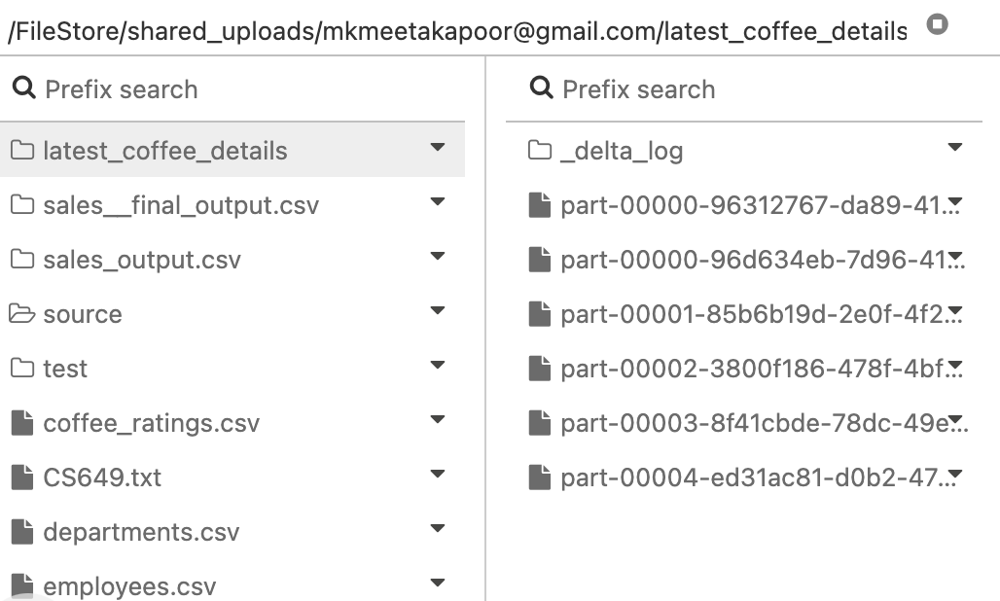
Target Data
Delta Table aggregated on country_of _origin

Slide 4
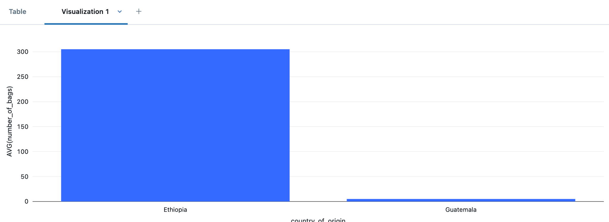
Final Aggregated Data

Slide 5
Popular ways to migrate data using pyspark
Batch Processing
Structured Streaming
upsert mode
append mode
complete mode

Slide 6
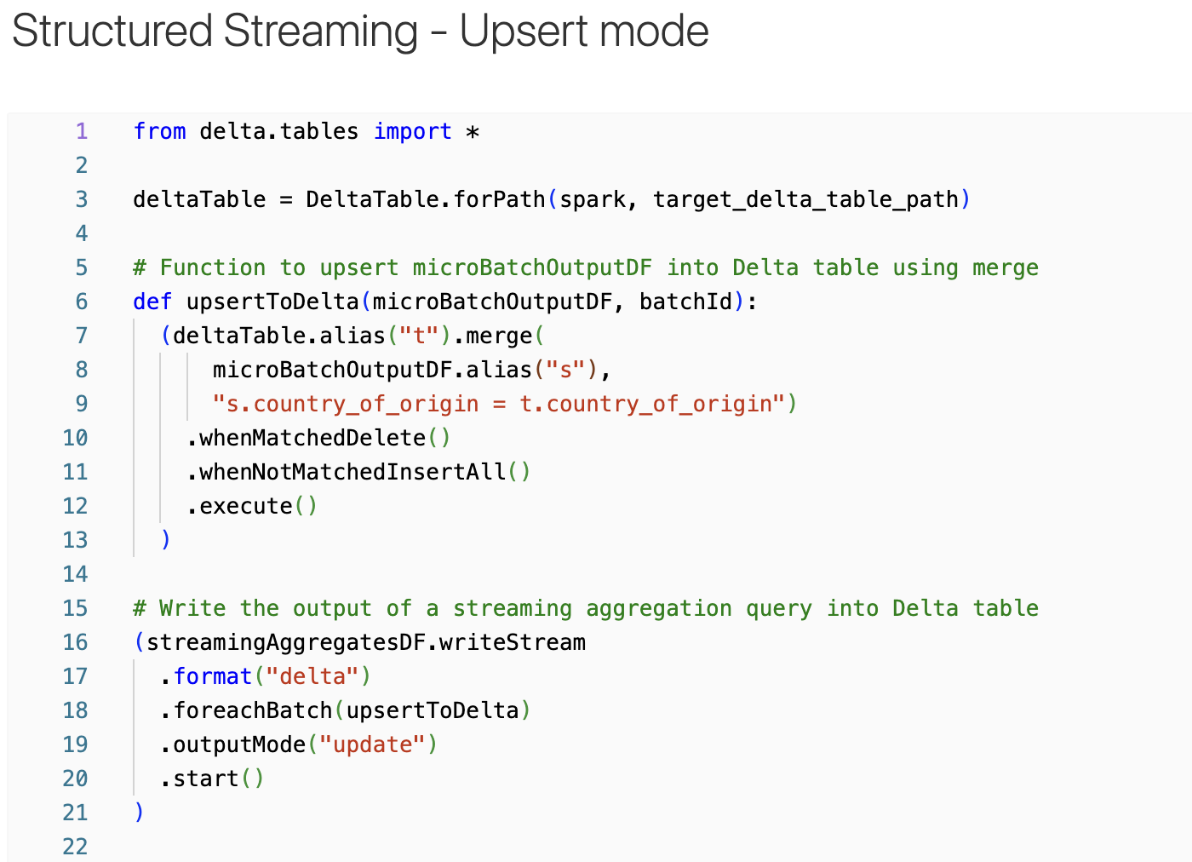
Process used - Structured Streaming

Slide 7
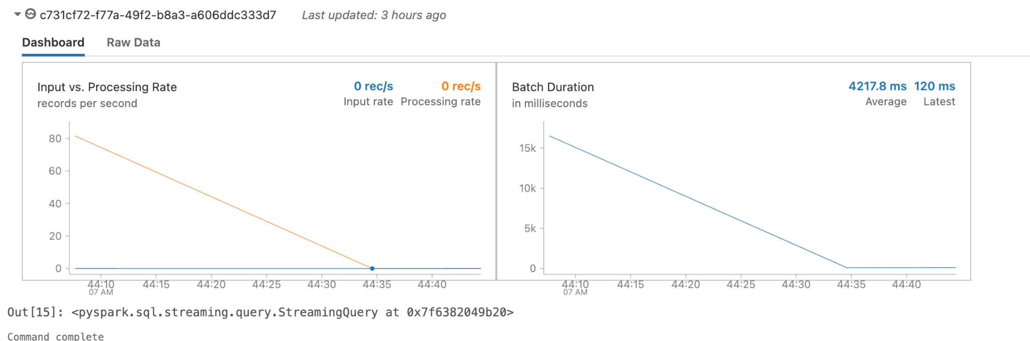
Structured streaming options - upsert mode, autoLoader, Triggers

Slide 8
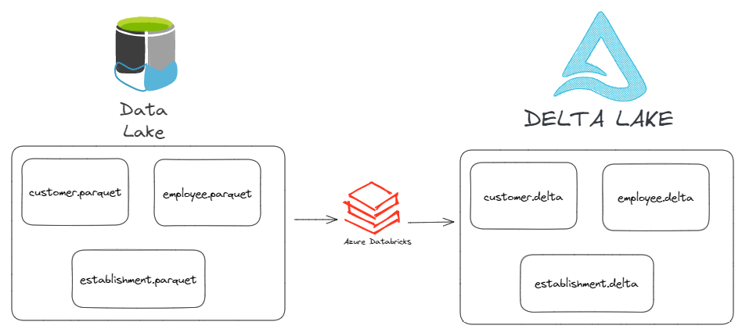
Real time use cases

Slide 9
Questions?

Slide 10

Thank You

